Slide 1
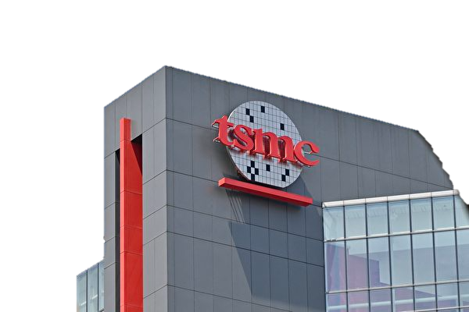
OPTIMIZATION
PORTAL-TOOLS- AIEDA
Date of conception: 2020/10/M
Main author: 曾一修 - 102663 Documentation written record: 2021/05/04

Slide 2

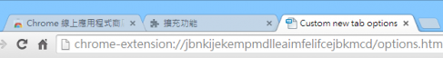

PROBLEMS
Problem 1: Memory Leak
Problem 2: Migrate System
Open the new tab through the portal.
For upgrading chrome impact.
Notes:
解決過往台積portal使用portal開分頁，會造成memory leak的問題。
Chrome升級導致系統也要跟著migrate的impact。

Slide 3
SOLUTIONS and BENEFITS
Problem Solved
Crash-resilient and Memory leak prevention:
Compared with other portal in tsmc are single process, every tabs in AIEDA are in isolated processes, even 1 tab occupies too many resources or even crashed, it won't affect the other tabs.
Native App feature:
Resolve Chrome upgrade issue and allow interaction with other rich client systems of tsmc.
Notes:
過往台積portal各分頁是共享一個process，但AIEDA的各分頁都是透過獨立的renderer process進行開啟，彼此間不會互相影響， 且即便某系統佔用太多資源甚至crash，也不會影響到其他分頁。
Native App特性：解決Chrome升級導致系統也要跟著migrate的impact，以及可以和其他台積rich client系統有更高的整合性。

Slide 4
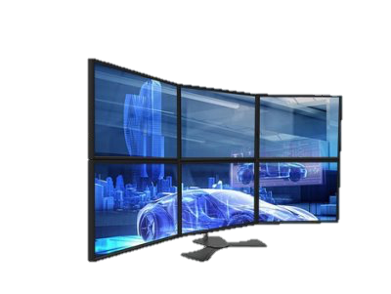
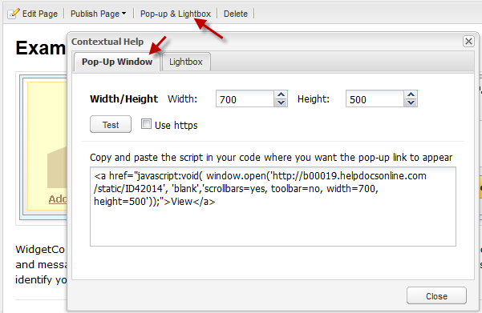

SOLUTIONS and BENEFITS
Additional Optimization
Multi-screen support:
Provide popup/popdown window and multi-screen display function to improve user analysis efficiency.
Optimize user experience:
Provide multiple fancy UI functions (Dark/Light mode switch, multi-screen support, etc.) and improve system performance through pre-rendering window.
Notes:
提供多螢幕分析功能：單一系統多螢幕顯示與popup/popdown window顯示系統，提升使用者的分析效率。
透過pre-rendering window pool來提升分頁開啟效能，以及提供fancy ui來提升ux。

Slide 5
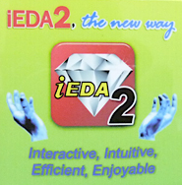

INTERFACE DRAFT
HeaderProcess
Main Process
ipc
Renderer Process
Renderer Process
Renderer Process
NEW TABS
Pre-rendering Window Pool
POP OUT
Renderer Process
AIEDA (Native APP)
Renderer Process
Renderer Process
Can be integrated and interacted with other rich client systems
Multi Screen support

Slide 6
SUMMARY for TARGET
AIEDA plan to be new generaton engineering data analysis (EDA) platform
which is a high performance, crash-resilient native app based on multi-process architecture.
Moreover, it avoid issues caused by chrome frequently update
and can high interact with other rich client system.

